Slide 1


FlyNet: Mid Semester Review
October 21st, 2015
Critical Design Review

Slide 2
Overview
Project Overview
Organizational Chart
Concept of Operations
System Overview
Subsystem Overviews
Hardware Platform
Flight Controls / Autopilot Interfacing
Perception and Mapping
Target Identification
Planning and Guidance
End of semester demo
Deliverables
Requirement Updates
Budget
Schedule

Slide 3
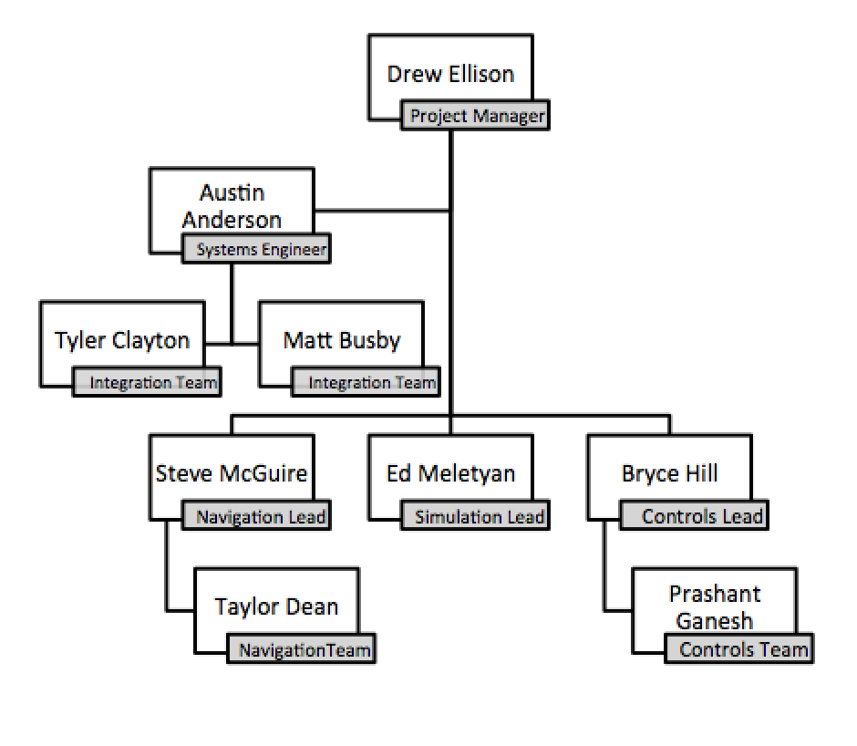
Organization Chart

Slide 4
Organization Chart

Slide 5
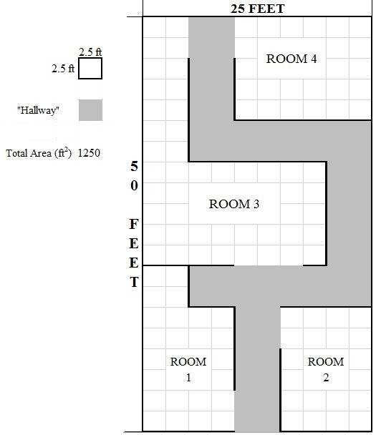
Concept of Operations
Autonomously explore an indoor environment with a team of ground/air robots in a disaster area situation
Map the environment and communicate that map to first responders
Identify humans in the environment and report their locations to first responders
Deliver a package to humans in the environment
“Roadblock”
“Target”
“Complete Block”
Entry/Exit Point

Slide 6
FlyNet: System Block Diagram
= Internal Software hosted on XU4
FLiR
Ground Station
= Off board system
= Sensor
Target Detection and Tracking
= Pixhawk
Guidance
SLAM
Planning
Flight Control
RC Overrides
= Internal software connection using ROS publish/subscribe
= SPI Video
= USB connection
= Wireless link

Slide 7
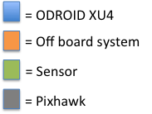
FlyNet: System Block Diagram
To SLAM:
5 x Grey-Scale Image @ 20 Hz
2 x Depth Map @ 20 Hz
Body Frame Velocity
(vN,vE,vD) @ 10 Hz
FLiR
Ground Station
To Planning:
5 x Obstacle distance @ 20 Hz
Target Detection and Tracking
Guidance
SLAM
Planning
Flight Control
RC Overrides

Slide 8
FlyNet: System Block Diagram
To Target D and T:
80x60 IR images @ 8.6 Hz
FLiR
Ground Station
Target Detection and Tracking
Guidance
SLAM
Planning
Flight Control
RC Overrides

Slide 9
FlyNet: System Block Diagram
To Planning:
Map (in octo-map representation) @ ~10 Hz
FLiR
Ground Station
To Planning and Flight Control:
Local NED @ ~10 Hz
To Target D and T:
Local NED @ ~10 Hz
Depth Map @ ~20 Hz
Target Detection and Tracking
Guidance
SLAM
Planning
Flight Control
RC Overrides
From Guidance:
See Guidance Slide
From Target D and T:
Target position estimate in local NED @ <8.6 Hz

Slide 10
FlyNet: System Block Diagram
To Planning, SLAM, Ground Station:
Target position estimate in local NED @ <8.6 Hz
FLiR
Ground Station
Target Detection and Tracking
Guidance
SLAM
Planning
Flight Control
RC Overrides
From FLiR:
80x60 IR images @ 8.6 Hz
From SLAM:
Local NED estimate @ ~10 Hz
Depth Map @ ~20 Hz
From Flight Control:
Attitude estimate in Euler Angles @ TBD Hz

Slide 11
FlyNet: System Block Diagram
To Flight Control:
POS Command in Local (or Global) NED @ Variable Hz
Attitude Command in Euler Angles @ Variable Hz
FLiR
Ground Station
Target Detection and Tracking
Guidance
SLAM
Planning
Flight Control
RC Overrides
From Target D and T:
Target Location Estimate @ <8.6 Hz
From SLAM:
Local NED estimate @ ~10 Hz, Map @ ~10 Hz
From Guidance:
5 x Obstacle distance @ 20 Hz
From Ground Station:
Operator Override Commands

Slide 12
FlyNet: System Block Diagram
To Target D and T:
Attitude estimate in Euler Angles @ TBD Hz
FLiR
Ground Station
Target Detection and Tracking
Guidance
SLAM
Planning
Flight Control
RC Overrides
From Planning:
Set-points (see planning slide)
From SLAM:
Local NED estimate @ ~10 Hz, Map @ ~10 Hz
From RC Overrides:
Arm signal
Max throttle control
From Guidance (TBD):
1 x Sonar distance @ 20 Hz

Slide 13
FlyNet: System Block Diagram
FLiR
Ground Station
Target Detection and Tracking
Guidance
SLAM
Planning
Flight Control
RC Overrides

Slide 14
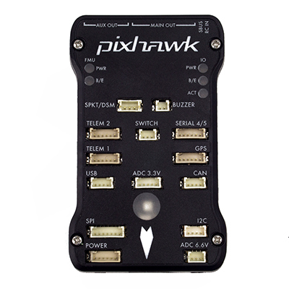
Autonomous Quadcopter Control
Requirement Motivation:
The system shall perform a search for targets in unknown environments with limited prior information.
The system shall be completely autonomous after mission initialization.
Proposed Solution (1st iteration) :
Onboard single board computer (SBC) to perform planning and navigation calculations.
Interface with Pixhawk autopilot and use onboard controllers for position/velocity control
Trajectory planning and obstacle avoidance will be done on the onboard companion computer, position and velocity setpoints sent to autopilot
If onboard controllers are not sufficient, modifications will be made to onboard controls architecture

Slide 15
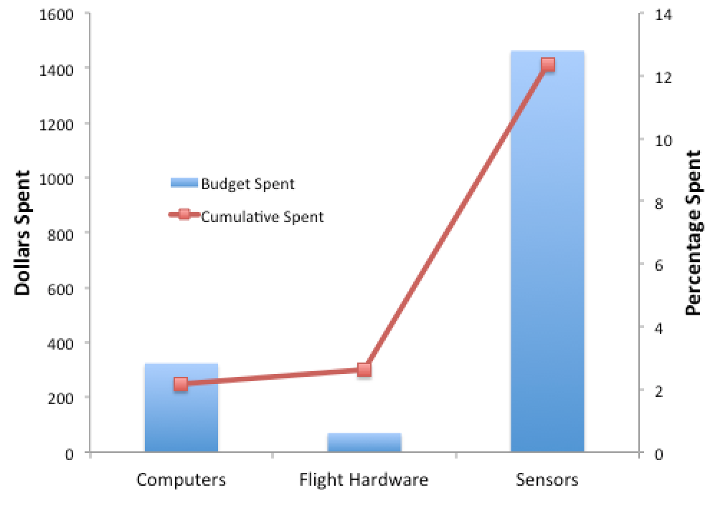
Budget
Currently Spent:
$1855.00 / 12.4%
Previous spending:
Quadrotor platform
Several single board computers (ODROID XU4)
Planned Spending:
Secondary platform:
Estimated to be $3000 per platform

Slide 16
Path Forward

